Slide 1


Najwa’s Freelance
Business
PROFILE
ZYLOPOP JEWELLERY LIMITED, Mbale

Slide 2
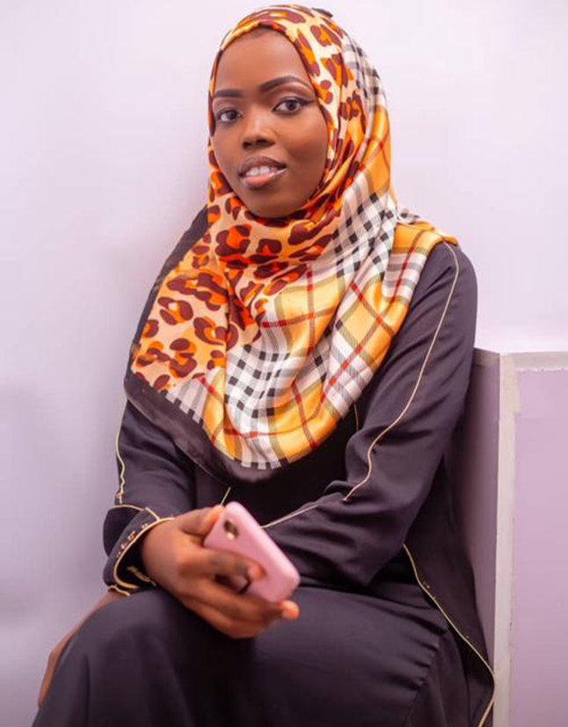

Najuwa Mwenyi
IKIGAI: (Purpose) - To inspire and empower individuals
- Passion: Facilitating personal growth.
- Vocation: Teaching and coaching in personal development and career advancement.
- Profession: Qualified teacher looking at changing people’s lives for the better
-Mission :To reduce the unemployment problem in my country through self reliance education
Notes:
PERSONALITY TYPE:
TARGET AUDIENCE:
- Young professionals seeking career guidance.
- Individuals looking for personal development and self-improvement strategies.
- Community organizations focused on educational outreach and support.
SKILLS:
- Effective communication and public speaking.
- Curriculum development and instructional design.
- Coaching and mentoring.
- Conflict resolution and problem-solving.
- Social media management and digital marketing.
VISION/GOALS:
- To create a platform for accessible education and personal development resources.
- To reach and mentor at least 500 individuals in the next five years.
- To establish partnerships with local organizations to promote community engagement and support.
- To write a book on personal growth strategies by 2027.
---

Slide 3
PERSONALITY TYPE : Extraverted, Intuitive, Feeling, Judging
- A hardworking lady, empathetic, and passionate about creating new things.
Notes:
PERSONALITY TYPE:
TARGET AUDIENCE:
- Young professionals seeking career guidance.
- Individuals looking for personal development and self-improvement strategies.
- Community organizations focused on educational outreach and support.
SKILLS:
- Effective communication and public speaking.
- Curriculum development and instructional design.
- Coaching and mentoring.
- Conflict resolution and problem-solving.
- Social media management and digital marketing.
VISION/GOALS:
- To create a platform for accessible education and personal development resources.
- To reach and mentor at least 500 individuals in the next five years.
- To establish partnerships with local organizations to promote community engagement and support.
- To write a book on personal growth strategies by 2027.
---

Slide 4
TARGET AUDIENCE:
- Gen-Z
- Individuals looking for personal development and self-improvement strategies.

Slide 5
SKILLS:
Calnary
Debatng
Innovation
Computing
Social Interactions

Slide 6
VISION/GOALS:
- To create a platform for Zylopop limited
- To reach and mentor at individuals in the next in both innovation line and computer skills
- To teach and influence individuals to be self reliate
- To write a book on personal growth strategies by 2027.

Slide 7
ZYLOPOP JEWELLERY LIMITED
Key Partnerships
Key Activities
Value Propositions
Customer Relationships
Customer Segments
High quality bead suppliers(glass, gemstones etc)
Designing and crafting unique patterns
One-on-one communication
Email or video call support
Personalized service
Follow-up support
Co-collection
Behind the scenes
Gift shoppers
Eco-conscious buyers
Handmade authenticity(Limited Edition)
Content creation (making process)
Inventory management
Gift Shops
Influencers
Local shops
Key Resources
Channels
Computer and internet access
Graphic designers or content writers (as needed)
Online payment platforms
Personalization
Custom names,colours and gemstones
Personal website/portfolio
Social media platforms
Freelance websites
Email communication
Word-of-mouth referrals
GEN-Z and PROFESSIONALS
Cost Structure
Revenue Streams
Marketing and advertising expenses
Training fees
Internet expenses
Materials
Time investment
Direct to customer
In person Event
Notes:
partner_network
===============
Kampala City Council Authority: Weyonjje initiative

Slide 8
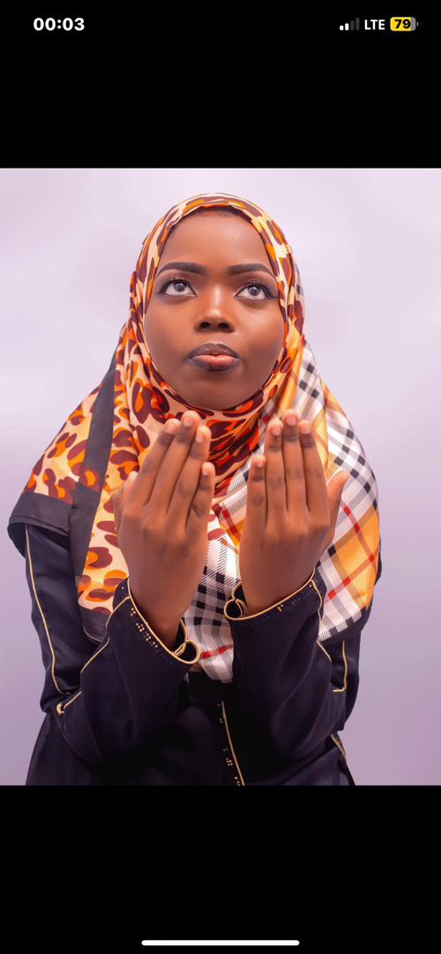

THANK YOU

